Slide 1
Introduction to
You Print (& Capture), We Manage
Michael Stebich
Regional Sales Manager

Slide 2




Why does Printix make sense in an MSP's portfolio?
Tight integration
and Partnership
with Microsoft
Automated migration of print servers
Automated Distribution of Queues and Drivers
Drastic reduction of support calls
Notes:
Supported by the message that Print remained with customers for a long time – because no MSP wanted to take this „hated“ topic on. But with that „rather new“ and very automated additional jigsaw piece the gaps in the portfolio close and the MSP keeps competition out of the game.

Slide 3










Microsoft – Native Integration
Further Integrations
Notes:
Entra (incl. Group Sync)
Entra ID
M365 (Mail, SharePoint, OneDrive)
Blobs
Universal Print
Azure SQL
Power BI

Slide 4










Independently
Deployment
msi tools
Integration capability
Capture SDK
Cloud Print API
Notes:
Icon1: Endpoint manager

Slide 5


Print, but safely!
Print later & Anywhere Print
Card Authentication
Authentication via smart phone
Encryption in transit (https) & at rest (AES265)
ISO 27001
SOC2-2

Slide 6
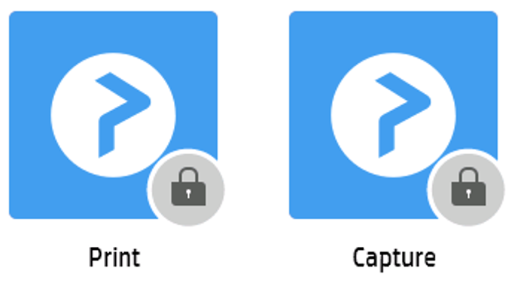

Slide 7
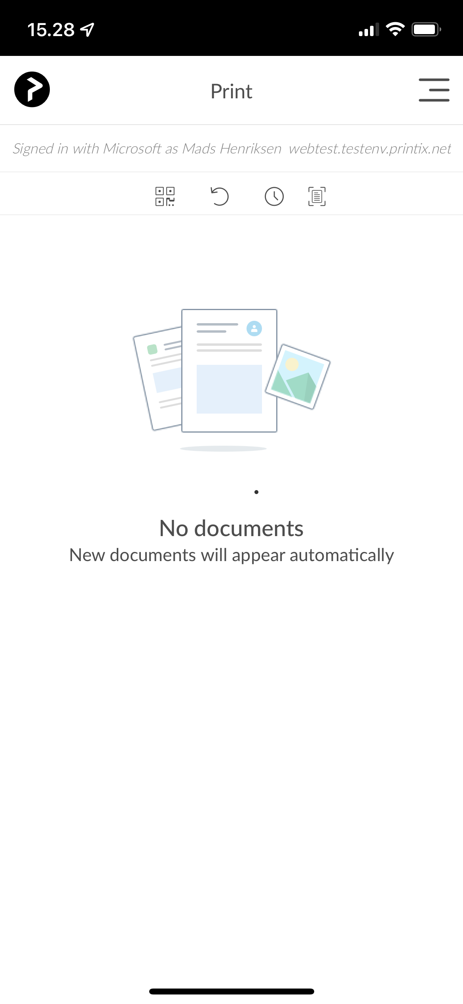
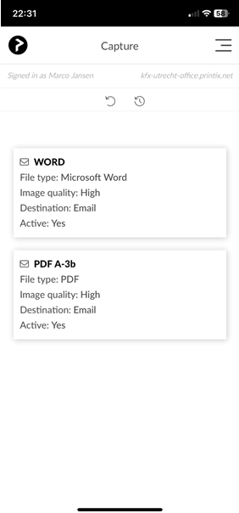
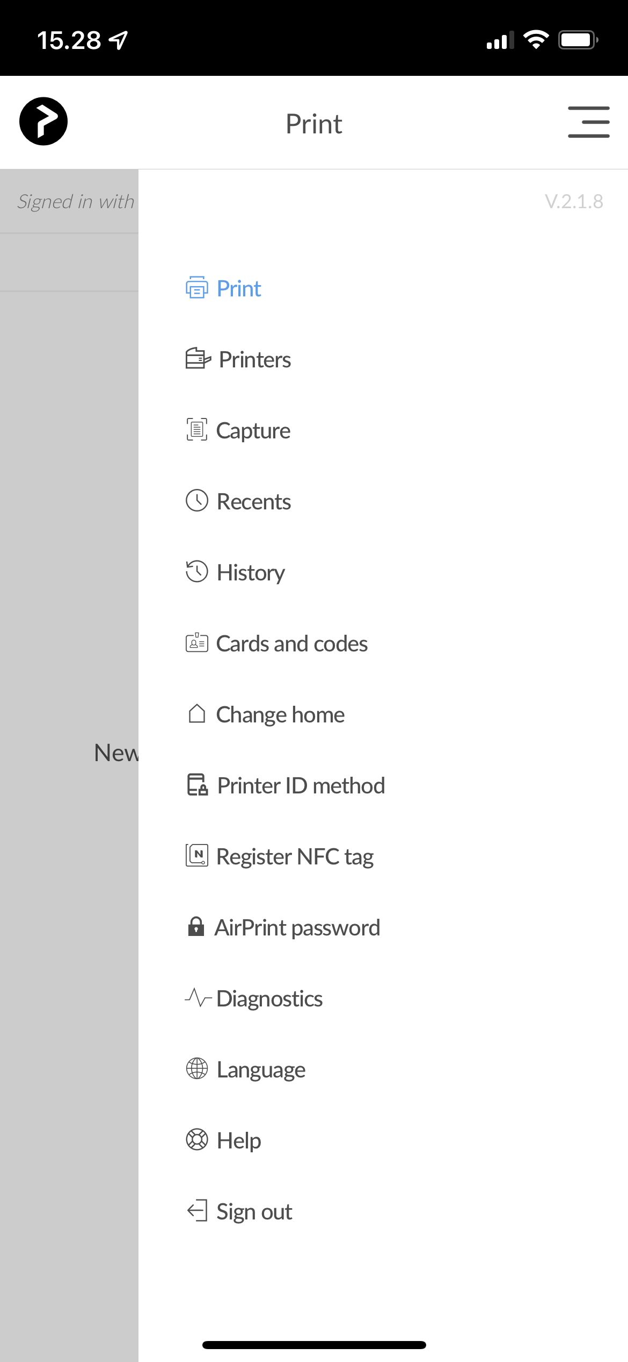
Mobile Device
7

Slide 8
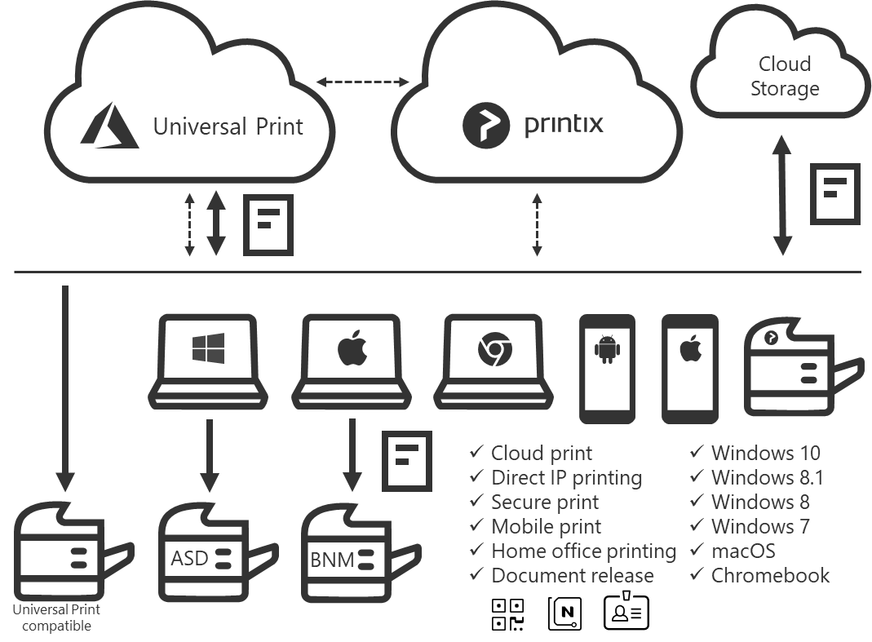





Printix Architecture
True SaaS
  Multi tenant
  micro services
  Restful API
Automatic upgrade, scaling and healing
  Redundant Docker containers
  Kubernetes service deployment
  Pager Duty 24/7 monitoring
  -> https://status.kofaxcloud.com/

Slide 9
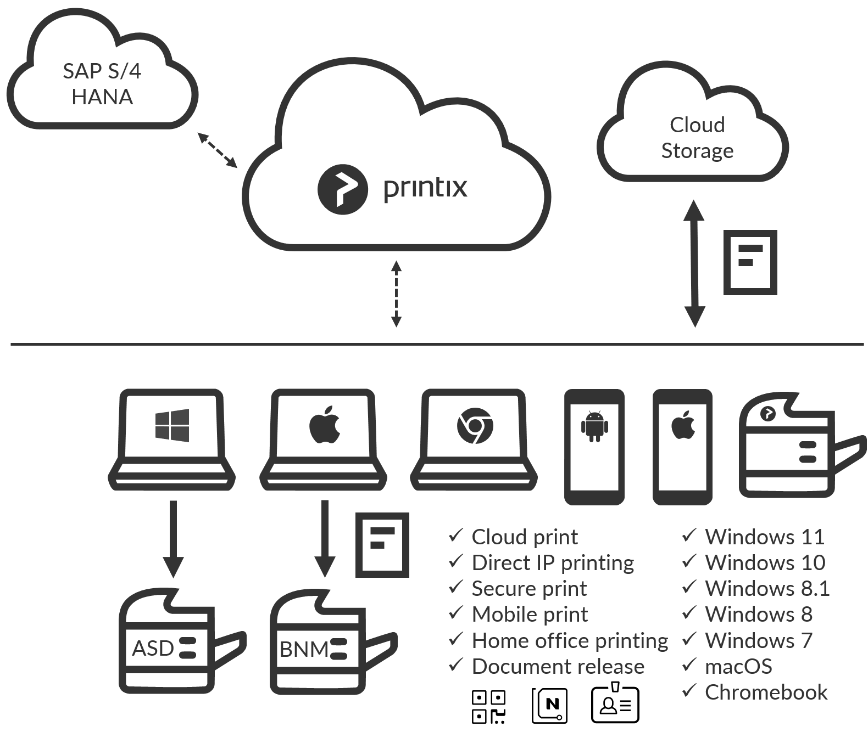
SAP Integration (optional)
What it is...
Simple and automated
Works with...
SAP ECC, GTS, SAP S/4 HANA
Functions...
Printer Synchronization
Direct Print, (Follow Me soon), Feedback into SAP, Logging

Slide 10

Distributed?
Hybrid?
Privat
Cloud
Storage
Secure?
Easy?
Small Office
5G
Stuttgart
Zürich
Home office
C
A
Printix
Redirector
ControlSuite
X
CFD
ASD
BNM
CFD
Notes:
Jedes Kundenszenario, ohne Teure HW, 1 Netzwerk, Mehrere Netzwerke, auch ohne Verbindung, Anbindung Außenstellen, Homeoffice …….
Ob Printix ausschließlich
Queue Mananagement in Kombination mit On-Prem Lösung
Egal wo die Daten liegen sie sind verschlüsselt.
Trotz allen Möglichkeiten und Sicherheitsmechanismen, Printix ist so wahnsinnig einfach, dass die technischen kollegen nichts anderes mehr machen wollen.

Slide 11

Printix offers the easy switch
Capex
Opex
Manual installation of the Print Queue
Automatic installation of the Print Queue
a server-based
a cloud-based print infrastructure
Help Desk Service
Intuitiver Self Service
Own scaling
Scaling as a Service
Manufacturer-specific
Vendor agnostic
Service Desk Healing
Healing as a Service
Self-managed security
Security as a Service
Local AD
cloud-based authentication and SSO
Traditional infrastructure
Modern, security-oriented infrastructure
Traditional management
Client-based management via e.g. MS Endpoint Manager

